Slide 1
File System Administration

Slide 2
File System
Operating systems, the software that powers your computer, rely on a crucial element known as the file system.
The Linux file system is a multifaceted structure comprised of three essential layers.

Slide 3
Linux File System Structure
A file system mainly consists of 3 layers. From top to bottom:
1. Logical File System:
The Logical File System acts as the interface between the user applications and the file system itself. It facilitates essential operations such as opening, reading, and closing files. Essentially, it serves as the user-friendly front-end, ensuring that applications can interact with the file system in a way that aligns with user expectations.

Slide 4
2. Virtual File System:
The Virtual File System (VFS) is a crucial layer that enables the concurrent operation of multiple instances of physical file systems. It provides a standardized interface, allowing different file systems to coexist and operate simultaneously. This layer abstracts the underlying complexities, ensuring compatibility and cohesion between various file system implementations.

Slide 5
3. Physical File System:
The Physical File System is responsible for the tangible management and storage of physical memory blocks on the disk. It handles the low-level details of storing and retrieving data, interacting directly with the hardware components. This layer ensures the efficient allocation and utilization of physical storage resources, contributing to the overall performance and reliability of the file system.

Slide 6
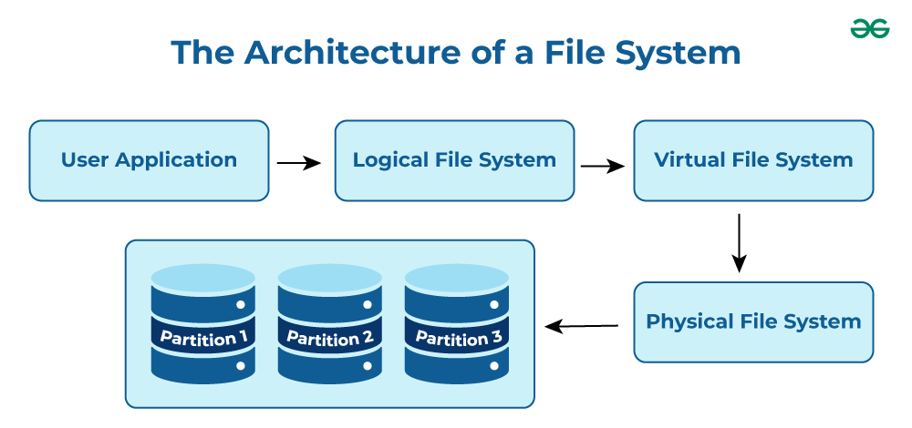

Slide 7
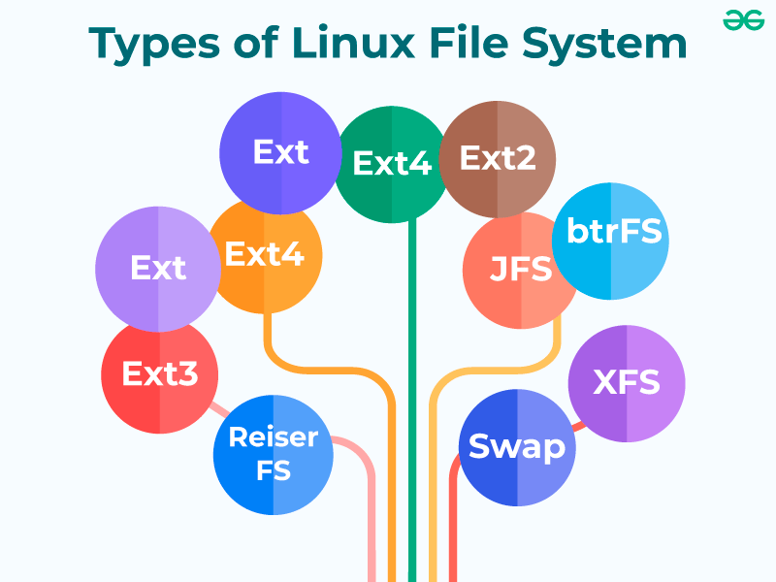

Slide 8
1) ext (Extended File System):
Implemented in 1992, it is the first file system specifically designed for Linux. It is the first member of the ext family of file systems.
2) ext2:
The second ext was developed in 1993. It is a non-journaling file system that is preferred to be used with flash drives and SSDs. It solved the problems of separate timestamp for access, inode modification and data modification. Due to not being journaled, it is slow to load at boot time.

Slide 9
3) ext3:
The third ext developed in 1999 is a journaling file system. It is reliable and unlike ext2, it prevents long delays at system boot if the file system is in an inconsistent state after an unclean shutdown. Other factors that make it better and different than ext2 are online file system growth and HTree indexing for large directories.
4) XFS:
XFS is a 64-bit journaling file system and was ported to Linux in 2001. It now acts as the default file system for many Linux distributions. It provides features like snapshots, online defragmentation, sparse files, variable block sizes, and excellent capacity. It also excels at parallel I/O operations.

Slide 10
5) ext4:
The fourth ext developed in 2006, is a journaling file system. It has backward compatibility with ext3 and ext2 and it provides several other features, some of which are persistent pre-allocation, unlimited number of subdirectories, metadata checksumming and large file size. ext4 is the default file system for many Linux distributions and also has compatibility with Windows and Macintosh.

Slide 11
Characteristics of a File System
Space Management: how the data is stored on a storage device. Pertaining to the memory blocks and fragmentation practices applied in it.
Filename: a file system may have certain restrictions to file names such as the name length, the use of special characters, and case sensitive-ness.
Directory: the directories/folders may store files in a linear or hierarchical manner while maintaining an index table of all the files contained in that directory or subdirectory.

Slide 12
Metadata: for each file stored, the file system stores various information about that file’s existence such as its data length, its access permissions, device type, modified date-time, and other attributes. This is called metadata.
Utilities: file systems provide features for initializing, deleting, renaming, moving, copying, backup, recovery, and control access of files and folders.
Design: due to their implementations, file systems have limitations on the amount of data they can store.

Slide 13
Some important terms
1) Journaling:
Journaling file systems keep a log called the journal, that keeps track of the changes made to a file but not yet permanently committed to the disk so that in case of a system failure the lost changes can be brought back.
2) Versioning:
Versioning file systems store previously saved versions of a file, i.e., the copies of a file are stored based on previous commits to the disk in a minutely or hourly manner to create a backup.
3) Inode:
The index node is the representation of any file or directory based on the parameters – size, permission, ownership, and location of the file and directory.

Slide 14
Installing XFS utilities package on Linux system.
Debian
sudo apt-get install xfsprogs
sudo mkfs.xfs /dev/sda1 –f
Mount the XFS partition to a directory we want.
sudo mount /dev/sda1 /mnt/jayesh_xfs_partition
To verify the mount.
df -h

Slide 15
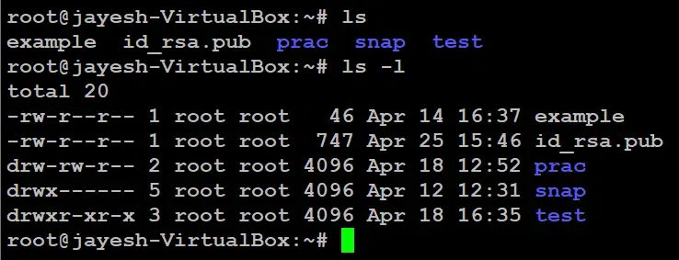
File and directory permissions and ownership
ls –l

Slide 16
There’s a lot of information in those lines.
The first character = ‘-‘, which means it’s a file ‘d’, which means it’s a directory.
The next nine characters = (rw-r–r–) show the security
The next column shows the owner of the file. (Here it is `root`)
The next column shows the group owner of the file. (Here it is `root` which has special access to these files)
The next column shows the size of the file in bytes.
The next column shows the date and time the file was last modified.
Last Column = File_name or Directory_name. (For example, here are: prac, snap, test, example)

Slide 17
What are the three permission groups in Linux?
Owners: These permissions apply exclusively to the individuals who own the files or directories.
Groups: Permissions can be assigned to a specific group of users, impacting only those within that particular group.
All Users: These permissions apply universally to all users on the system, presenting the highest security risk. Assigning permissions to all users should be done cautiously to prevent potential security vulnerabilities.

Slide 18
--- --- ---
rwx rwx rwx
user group other

Slide 19
For instance to sets read and write permissions for the owner and read-only permissions for the group and others for all text files in the directory.
chmod 644 *.txt

Slide 20
Disk usage and monitoring
Monitoring the performance and health of a Linux system is essential for maintaining its stability and optimizing resource utilization. Linux provides a variety of commands and tools to facilitate system monitoring, enabling administrators to track key metrics, identify potential issues, and ensure efficient operation.

Slide 21
Top command
The top command is super useful for monitoring what processes are using the most CPU and memory on your Linux system. It gives you a dynamic real-time view that updates frequently to show any changes. To use it simply open a terminal type “top” and hit enter. You then see a table with different columns like CPU and MEM usage percentages, process IDs, user accounts running each process, and the actual command names.

Slide 22
2. vmstat command
The vmstat command helps monitor your Linux system’s memory and CPU usage over time. It gives you snapshots of important statistics like memory, swap, IO, and CPU activity.
3. free command
The free command in Linux is used to display information about the system’s memory usage. When you run the free command without any options, it provides details about the total, used, and free physical and swap memory on your system.

Slide 23
netstat command
The netstat command is super handy for monitoring network connections and activity on your Linux machine. You can use it to see open ports, established connections, listening services, packet statistics, and more. This helps you understand what’s happening on your network.

Slide 24
There are two commands from which you can check free disk space. You have to enter these commands and can check disk space in Linux and Unix server.
1. df command : df command displays the amount of free disk space which is available on file system. This command displays each file name argument.
2. du command : The du command list all the contents and files which their sizes. This command is useful to track space hogs.

Slide 25
How to use df command ?
$ df -h
OR
$ df –k
fdisk –l
parted -l

Slide 26
Disk Partitioning in Linux
Disk Partitioning is the process of dividing a disk into one or more logical areas, often known as partitions, on which the user can work separately.
If a partition is created, the disk will store the information about the location and size of partitions in the partition table. With the partition table, each partition can appear to the operating system as a logical disk, and users can read and write data on those disks.

Slide 27
Why do we need it?
To upgrade Hard Disk (to incorporate a new Hard Disk into the system)
Dual Booting (Multiple Operating Systems on the same system)
Efficient disk management
Ensure backup and security.
Work with different File Systems using the same system.

Slide 28
Create partition using Fdisk
While partitioning, we should be aware of certain factors.
On a disk, we can have a maximum of four partitions.
The partitions are of two types.
Primary
Extended
Extended partitions can have logical partitions inside it.
Among the four possible partitions, the possible combinations are.

Slide 29
All 4 primary partitions
3 primary partitions and 1 extended partition

Slide 30
Create a File System on the Partition
Computers use particular kinds of file systems to store and organize data on media, like Hard Disk, CD, DVD, etc. The commonly used Linux file systems are ext2, ext3, ext4, JFS, ReiserFS, XFS, FAT (usually in Windows OS) and B-treeFS. Inorder to specify the file system to be used in each partition, we can use the mkfs (make file system) command.

Slide 31
mkfs.ext4 -j /dev/sdb1
What this command does is that it will make the first partition’s file system to be ext4 (format the partition to ext4). -j flag is used to allow/support journaling. It helps in throwing errors into the journal, in case of system failure.

Slide 32
mkfs.fat /dev/sdb2
This command is used to format the 2nd partition available in /dev/sdb2 to the FAT file system. Even though we formatted the disks, it is of no use to us, unless we mount it on a directory.

Slide 33
Mounting the file systems
Let us make three directories, for mounting the first, second, and third partition using the mkdir (make directory) command.
mkdir /mount1
mkdir /mount2
mkdir /mount3
Mounting the formatted partitions can be achieved using the mount command.

Slide 34
mount /dev/sdb1 /mount1
mount /dev/sdb2 /mount2
mount /dev/sdb3 /mount3
The first part of the command is the keyword mount, followed by the partition and the directory to which the mounting is to be done. To view the disk details, we can use the df command. h flag helps to display the output in a human-readable format.
df -h

Slide 35
Unmounting a disk can be achieved by unmount command.
unmount /dev/sdb2
All these mountains are temporary in nature. Once we reboot the system, mounting will be reverted. To make it permanent, we must edit the File System Table of the Operating System. We should be highly careful whirling with this file. A small error in this file can cause the system to be unbootable and can make the entire system to be useless. Let us open the file in any editor (I will be using the VI editor).
vi /etc/fstab
To verify: lsblk

Slide 36
Disk partitions and mounting in CentOS 7
Creating Hard Disk partition
Formatting Hard Disk partition
Mounting Hard Disk partition
Checking mounted file system
Making permanent mount file system

Slide 37
Creating Hard Disk partition
parted –l
parted /dev/sda
(parted) mklabel msdos
(parted) mkpart primary ext4 0 10024MB
(parted) print
(parted) mkpart primary ext4 10.0GB 17.24GB
(parted) print
(parted) mkpart primary ext4 10.0GB 17.24GB
(parted) print
(parted) quit

Slide 38
Next, create the file system type on each partition, you can use the mkfs utility (replace ext4 with the file system type you wish to use).
# mkfs.ext4 /dev/sda
# mkfs.ext4 /dev/sda1

Slide 39
you need to mount them by creating the mount points and mount the partitions.
# mkdir -p /mnt/sdb1
# mkdir -p /mnt/sdb2
# mount -t auto /dev/sdb1 /mnt/sdb1
# mount -t auto /dev/sdb2 /mnt/sdb2
df -hT

